Slide 1
Centralized Management of Liqo Provider-to-Provider Network Creation

Slide 2
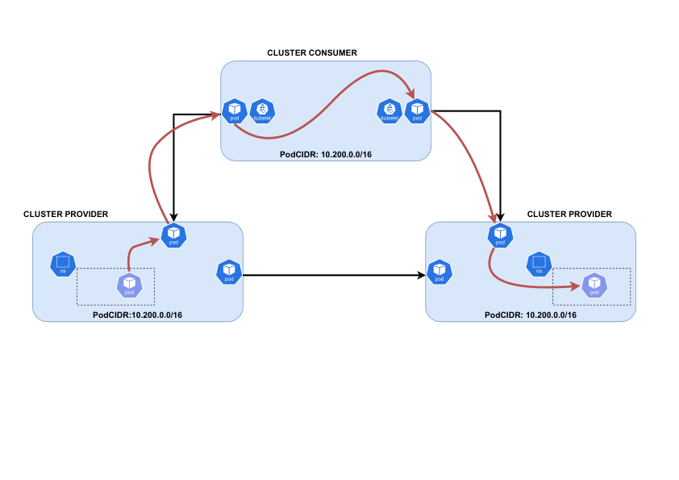
Standard topology

Slide 3
Current Problems
Management of direct connections (shortcuts) between foreign clusters (providers) is decentralized.
`liqoctl network connect` must be run manually on one of the foreign clusters.
The consumer cluster is unaware of these direct connections:
Cannot track or manage them centrally.
Cannot optimize routing or IP propagation based on shortcuts.

Slide 4
Proposed Architecture
CR and controller are hosted on the consumer cluster.
CRs are used to manage direct connections between foreign clusters.
Operator reconciles connection lifecycle based on CR definitions.
Ensures centralized orchestration and monitoring of shortcuts.

Slide 5
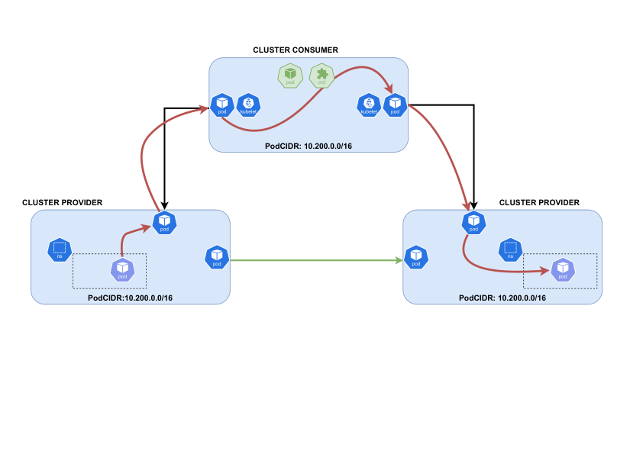
Example topology with controller and CR

Slide 6
Main Benefits of the New Solution
Centralized management of direct connections between clusters.
The main cluster gains visibility over all shortcut connections.
Enables future optimizations for routing and IP propagation.

Slide 7
Main features of the solution
New CRD ForeignClusterConnection(fcc) to represent shortcut connections.
Operator support for creating and removing these connections.
Dedicated CLI (`liqo-shortcut`) to simplify user experience.

Slide 8
ForeignClusterConnection CR
Declarative Spec-Only API
Users only need to define spec fields (foreignClusterA, foreignClusterB, networking)
Built-in Networking Configuration
Fine-grained flags in NetworkingConfig (MTU, gateway types, timeouts, etc.)
Automatic Status Population
Controller reconciles connection lifecycle at runtime
Populates status.isConnected, status.phase, lastUpdated, and detailed per-cluster CIDRs

Slide 9
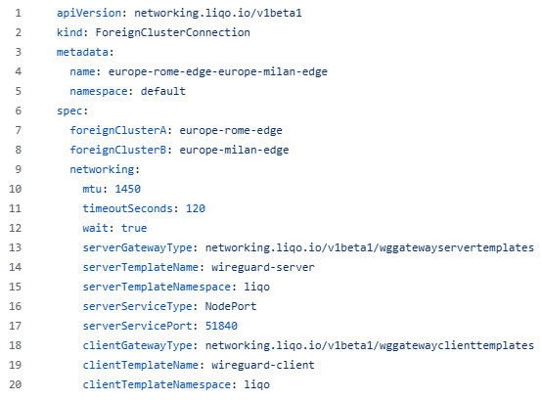
ForeignCLusterConnection example

Slide 10
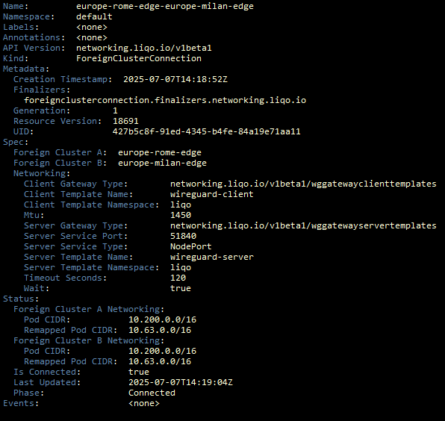
FCC example after connection

Slide 11
Operator ForeignClusterConnector
On CR creation
Automatically fetches and configures kubeconfigs for both clusters
Establishes a WireGuard tunnel using the networking settings from the CR
Updates the CR’s status with connection state and remapped Pod CIDRs
On CR Deletion
Tears down the specific tunnel between the two clusters
Deletes all related gateway and service resources

Slide 12
The New CLI
One-command install or uninstall of the controller
Create or delete a connection by naming the two clusters (with optional network flags)
Default settings applied when flags are omitted
No manual CR editing—zero YAML typos
Consistent, repeatable commands for scripts and CI/CD pipelines

